Slide 1
Automatic Program Repair by Claire Le Goues, Michael Pradel, Abhik Roychoudhury
In Proceedings of Communications of the ACM

Slide 2
- ABSTRACT
Automated program repair can relieve programmers from the burden of manually fixing and mistakes.
This article presents an state-of-the-art tools and techniques in automated program repair.

Slide 3
Introduction.
Developer is confident that program will pass all the test.
>Continuous integration system report fail
>Automated repair techniques try to automatically identify patch for a given bug.
>For some reasons apr we need.

Slide 4
use case
1. Fixing Bugs throughout Development
Ex) Apche libraries,facebook.
2. Repairing Security Vulnerabilities
Many security vulnerabilities are explitable memory errors or programing errors
Sol) Springfield(MS),OSS-FUZZ(Google)
3. Intelligent Tutoring.
They guide the students to a solution, rather than reapiring their broken solution. Provide hint instead of direct solution.
4.Self-Healing of Performance Bottlenecks.
For non functional issues, such as performance bottlenecks can provide such self-healing abilities.

Slide 5
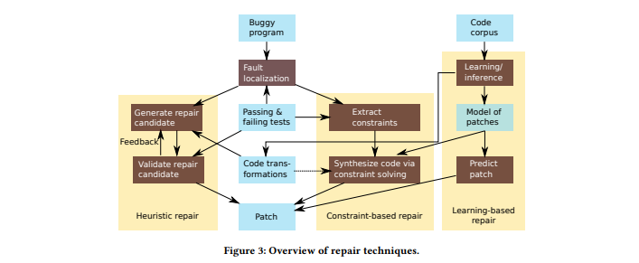
There are two main approaches, heuristic repair and constraint-based repair.

Slide 6
Heuristic repair stages.
Mutation selection. Due to the combinatorial explosion of possible mutations, the number of program variants that can be generated and compiled is typically very large. So must limit the type and variety of edits.(some techniques limit edits to only deletion,insertion, or replacement of code at the statement or block -level)
Test execution. Most expensive step, test suite selection and prioritization may be included search strategies don`t require a fitness function
Traversal strategy. Techniques vary in how they choose which patches to exploe, and in what order.

Slide 7
Constraint-based Repair
In constrast to heuristic repair techniques, proceed by constructing a repair constraint that the patched code should satisfy, as above figure.
Symbolic execution or other approaches extract properties about the function to be synthesized
Solutions to the repair constraint can be obtained by constraint solving or other search techniques

Slide 8
Learning based repair
Recent improvements in advanced machine learning, especially deep learning, and the availability of large numbers of patches enable learning-based repair
Such a model predicts for a given piece of buggy code the repaired code, without relying on any other explicitly provided information.
In particular, in contrast to the repair techniques in earlier sections, such models do not rely on a test suite or a constraint solver

Slide 9
Repair of non-functional properties.
To help developers improve the software efficiency, several approaches identify optimization opportunities and make suggestions on how to refactor the code to improve performance.
To mitigate security threats, various techniques for repairing programs at runtime have been proposed
These approaches automatically rewrite code to add a runtime mechanism that enforces some kind of security policy.

Slide 10
Perspectives and challenges.
We identify three core challenges :
increasing and ensuring the quality of repairs,
extending the scope of problems addresed by repair ,
and integrating repair into the development process

Slide 11
Quality
Measures of Correctness. An important aspect of fix quality is whether the fix actually corrects the bug.
버그 실제로 고쳐지는지에 대한 양상.
Alternative Oracles. The bulk of the existing literature focuses on test-based repair where the correctness criteria is given as a test case
테스트 케이스로 주어지는 정확성 기준이되는 수리
Correctness Guarantees. Few of today’s repair techniques provide any guarantees about the correctness of produced patches, which can hinder the application of automated repair, especially to safetycritical software
정확성 보장
Maintainability. Once a correct fix has been detected and applied to the code base, the fixed code should be as easy to maintain as a human fix
유지보수

Slide 12
Scope
The scope challenge is about further extending the kinds of bugs and programs to which automated repair applies.
자동복구가되는 버그의 종류가 확장되는것.
General-purpose repair.
Research in program analysis has long focused on special-purpose repair tools for specific kind of errors, such as buffer overflow errors, or bugs in domain-specific languages
Complex programs and patches.
Many of the key innovations in the initial research in program repair concerned the scalability of techniques to complex programs

Slide 13
Development Process
Integration with bug detection
버그감지와 통합
IDE integration
통합개발환경
Interactivity
수리 환경과 개발자와의 상호작용이 필요할 수 있다.
Explaining repairs
수리에 대한 설명

Slide 14
Conclusion
Technically speaking, automated repair involves challenges in defining, navigating and prioritizing the space of patches.
기술적으로, 패치공간과 탐색 및 우선순위 지정 문제등의 해결과제가 있고
Conceptually speaking, automated program repair closes the gap between the huge manual effor spent today in writing correct programs
개념적으로는 자동화된 프로그램 수리는 현재 올바른 프로그램을 작성하는데 소비되는 엄청난 수동 효율성 사이의 격차를 줄여준다.
Pragmatically speaking, automated program repair also makes us keenly aware of the challenges in managing changes in software engineering projects,
실용적으로는 자동화된 프로그램 복구는 또한 소프트웨어 엔지니어링 프로젝트의 변경사항 관리에 있어 당면한 과제를 잘 인식 한다
In future prograrm repair can provide tool support by repairing bugs from complex changes in software project.

Slide 15
Next studies
Real-world examples of autmative repair
Example facebook`s sapix and getafix and so on

